Slide 1

SINGAPORE’s PUBLIC HOUSING CONUNDRUM

Slide 2
HistORY AND POLICY ANALYSIS
Housing and Development Board in Singapore
Public Housing vs Private housing
BTO vs Resale
Current policy – Brave the balloting process or pay premium for resale
Grants
Why is renting not common?

Slide 3
PROBLEMS
Oversubscription
Multiple BTO attempts, forced to resale market, upward demand and prices
Affordability
Use as a speculative tool - 419 HDB flats were sold for $1 million or more in the first half of 2024.
Impacts
2021 Saguin study quantified impact, finding a statistically significant decline in fertility rates with rising housing prices. For example, a unit increase in resale flat prices reduced the total fertility rate by 0.0036

Slide 4
KEY GRAPHS

Slide 5
KEY GRAPHS

Slide 6
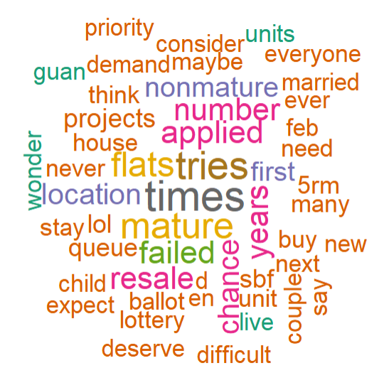
Anecdotal data
WordCloud analysis on the reddit post with 456 comments “Today I failed* to get a BTO** flat for the 9th time in a row” by user u/ValuablePie in r/Singapore a subreddit with 1.5 million members.

Slide 7
SOLUTIONS
Better demand forecasting
Use historical data, simulation tools, continuous improvement of the BTO algorithm
Preserving intent of public housing
Deter speculation through claw back of grants– if profit beyond a certain % - balance seller motivation and affordability.
Rental support
Scale policy to support all married couples - vouchers to supplement rent costs in the open market
Targeted support for unsuccessful BTO applicants

Slide 8
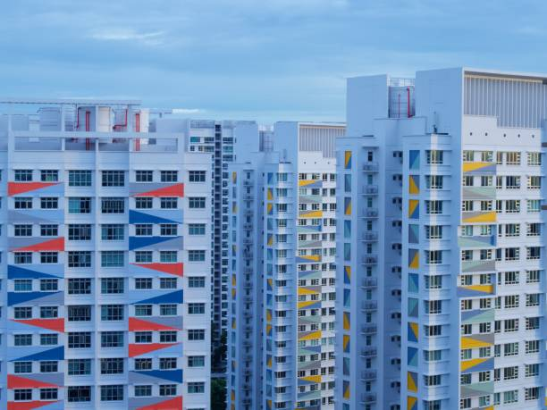
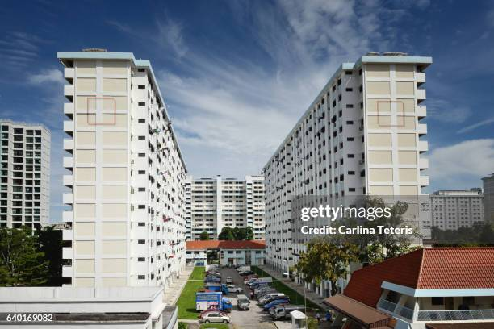
ACROSS THE WORLD
Private market – comparable to mega cities in rest of the world
Tokyo – zoning policies, urban density
Hong Kong – short term sales high stamp duties
New York and SFO – rent control
Singapore
land reclamation
Use of CPF to service mortgage
HDB Singapore

